Slide 1
IV CORPS
CJTF-82
LAND COMPONENT COMMAND
IV CORPS
CONOPS, PHASE 1
DISCLAIMER:
This is for multiplayer online gaming using the Digital Combat Systems simulation software published by Eagle Dynamics. The information is not in any way suitable for real world use or operations.
Version: 1.1
Published: 2020-09-10

Slide 2
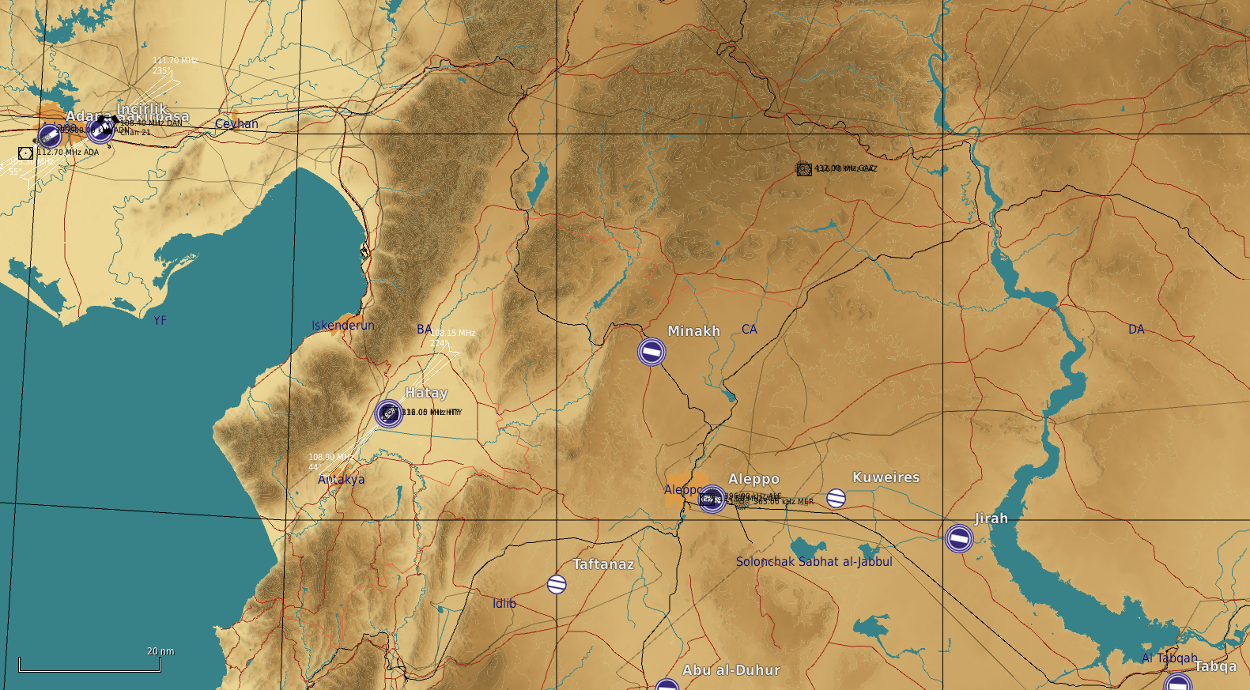
ENEMY SITUATION (D+0)
IV CORPS
The basic fighting formation in the Syrian army is the division. Here is a representation of a division during an offansive.
The three manuevering brigades (Composed of armor and mechanized forces) are arranged in a «2-front, 1-rear» formation. This arrangement allows for an offensive over a wide front with a lot of firepower, while still having the 3rd brigade close behind. The rear-brigade is ready to support any of the front two brigades in case of high enemy resistance, or to exploit a success breakthrough, and pushing a fresh force forward into the enemy teritorry. The movement of the rear brigade forward may be done between the two front brigades, or directly «through» one of them – depending on terrain, roads and tactical situation.
One of the frontal brigades will be designated as the Main Effort (ME). This brigade will have priority in receiving support from the division-level assets. As shown here, Front Brigade #1 is the ME and is supported by the division’s Rocket-ARTY BN.
Further to the back are the divisional HQ, the logistics BN and an SA-15 BN protecting them.
A second BN of SA-8 will be close to the divisional Rocket-ARTY BN, defending it.
56th Armored Division
55th Mechanized Division
10th Armored Division
2nd Corps
11th Mechanized Division
1st Corps HQ
12th Motorized Division

Slide 3
Concept of Operations (CONOPS)
IV CORPS
The basic fighting formation in the Syrian army is the division. Here is a representation of a division during an offansive.
The three manuevering brigades (Composed of armor and mechanized forces) are arranged in a «2-front, 1-rear» formation. This arrangement allows for an offensive over a wide front with a lot of firepower, while still having the 3rd brigade close behind. The rear-brigade is ready to support any of the front two brigades in case of high enemy resistance, or to exploit a success breakthrough, and pushing a fresh force forward into the enemy teritorry. The movement of the rear brigade forward may be done between the two front brigades, or directly «through» one of them – depending on terrain, roads and tactical situation.
One of the frontal brigades will be designated as the Main Effort (ME). This brigade will have priority in receiving support from the division-level assets. As shown here, Front Brigade #1 is the ME and is supported by the division’s Rocket-ARTY BN.
Further to the back are the divisional HQ, the logistics BN and an SA-15 BN protecting them.
A second BN of SA-8 will be close to the divisional Rocket-ARTY BN, defending it.
OBJ A
OBJ C
OBJ B
OBJ D

Slide 4
STAGES
IV CORPS
This phasen will be conducted in 5 stages:
Stage 1: ( D+0)
Assemble forces in assembly areas
Stage 2: ( D+1 to D+2 )
Shaping: Artillery and attack from JFACC
Focus on both Objective A, B and C to keep enemy unaware of our intention
Stage 3: (D+3 to D+4)
Main effort: 56th Armored Division: Quick offensive operation to seize objective A and B
Intention is to neutralize enemy 10th Armored Divison, and do a deep thrust to take objective B, so enemy 12th Motorized Divison is cut off.
Secondary effort 1: Attack by JFACC enemy 12th Motorized Divison
55th Mechanized Division in defensive positions preventing enemy to break out NORTH.
Secondary effort 2: Attack by JFACC enemy 11th Mechanized Division
Prevent enemy 11th Mechanized Division to reinforce enemy 10th or enemy 12th Division.
Stage 4: (D+5 to D+6)
Main Effort: 55th Mechanized Division: Offensive SOUTH to attack and seize objective C.
Secondary effort 1: Blocking by 56th Armored Division
Prevent effective support from enemy 11th Mechanized Division
Secondary effort 2: Attack by JFACC
Neutralize enemy 11th Mechanized Division to set conditions for stage 5.
Stage 5:
Conduct rearm, refuel and prepare for PHASE 2, offensive into Syria.

